Slide 1

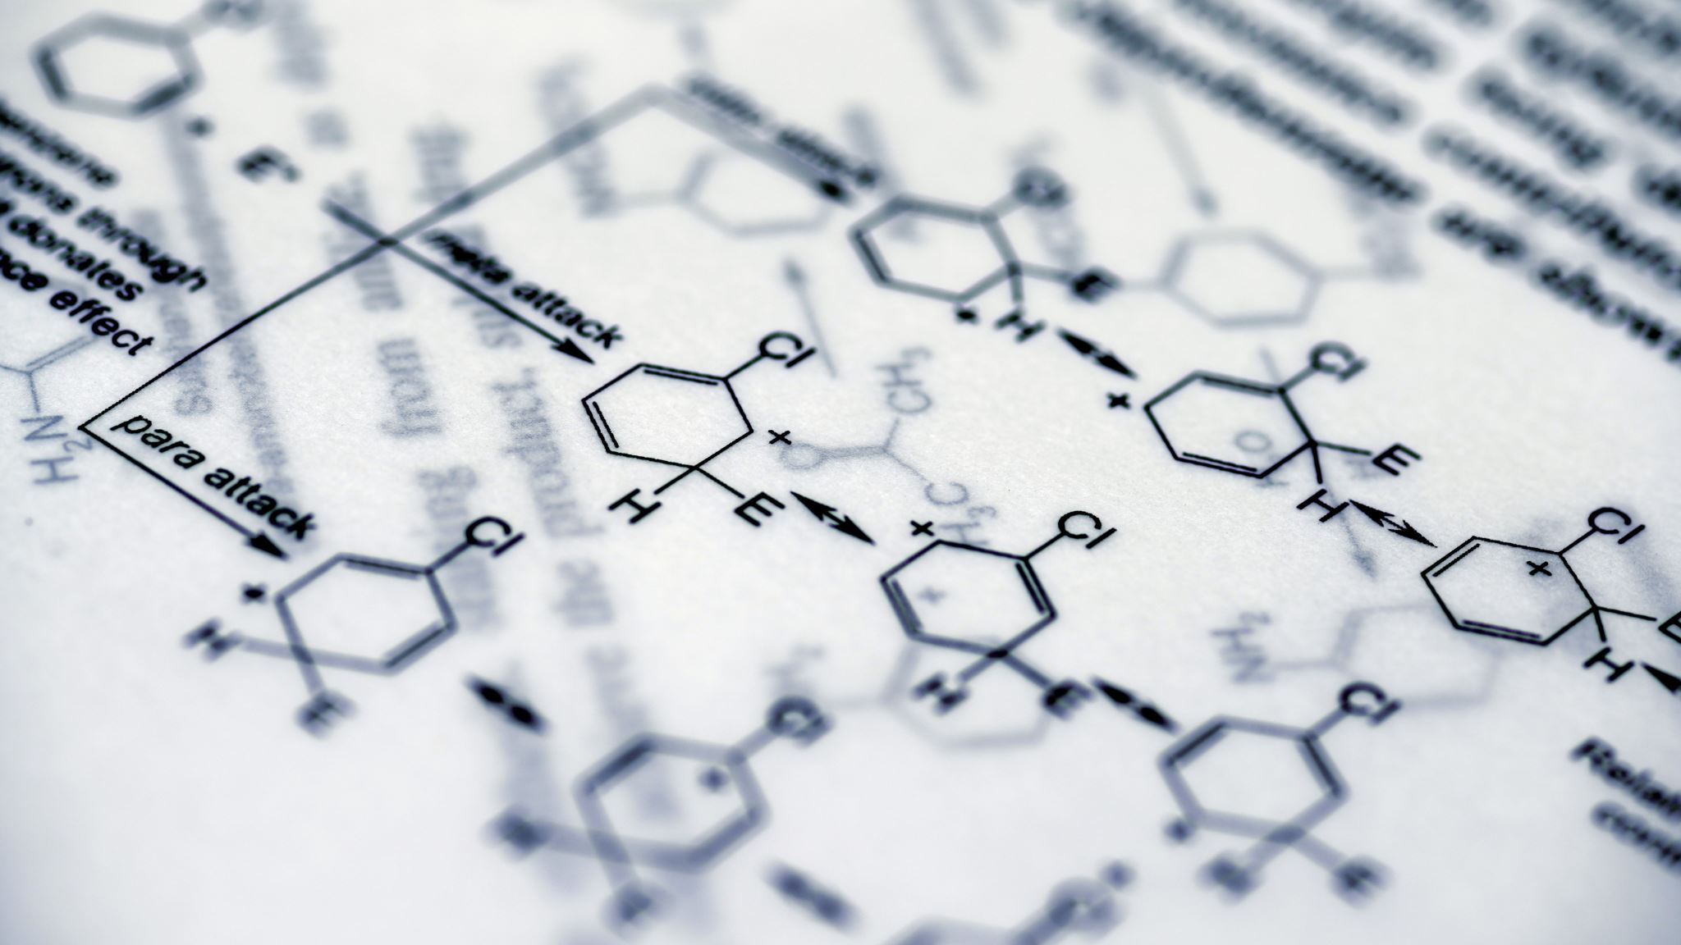
Metabolic Profile Characterization From Single-cell RNA-seq Data
Oumar Ndiaye
Department of Biotechnology
University of Verona

Slide 2
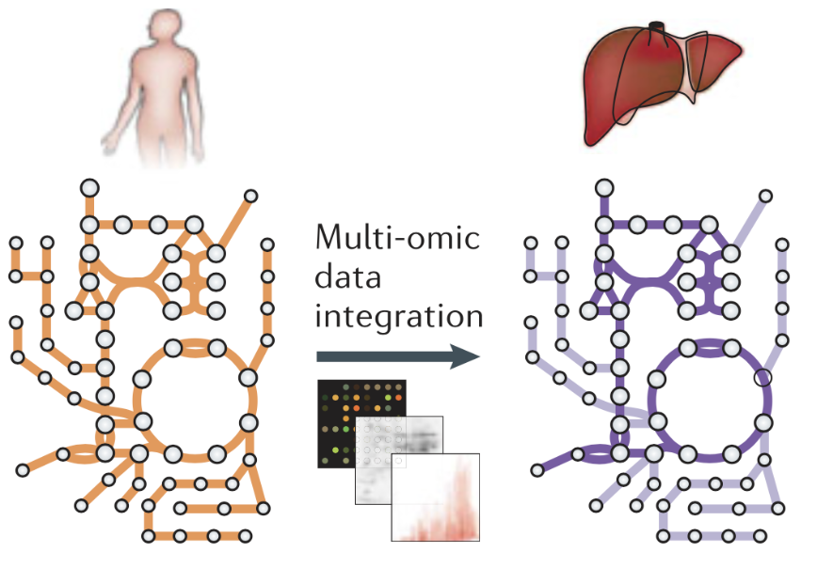
Genome-Scale Metabolic Models & Flux Balance Analysis
Genome-Scale Metabolic Models (GSMM)
mathematical reconstruction of the metabolism gene → reaction → metabolite
Flux Balance Analysis (FBA)
mathematical approach to analyse the flow of metabolites through a metabolic network
in particular, the GSMM reconstructions
very insightful when contextualized with functional genomic data
Adapted from Palsson B., “Systems biology: constraint-based reconstruction and analysis”, Cambridge University Press, 2015
Notes:
Let’s start by briefly introducing 2 main concepts at the basis of this work which are genome-scale metabolic models and flux balance analysis.
A genome-scale metabolic model - GSMM - is a mathematical representation of the metabolism of an organism and It provides extensive gene-reaction-metabolite connectivity. Conceptually, we can visualize it as a network connecting all the different metabolic pathways in an organism.
Flux balance analysis – FBA - , on the other part, is a widely used mathematical approach to analyse the flow of metabolites through a metabolic network and in particular the GSMM reconstructions. FBA can be very insightful when contextualized with functional genomic data. Indeed by integrating omic data we can determine constraints through which we can enhance the analysis of a metabolic network

Slide 3
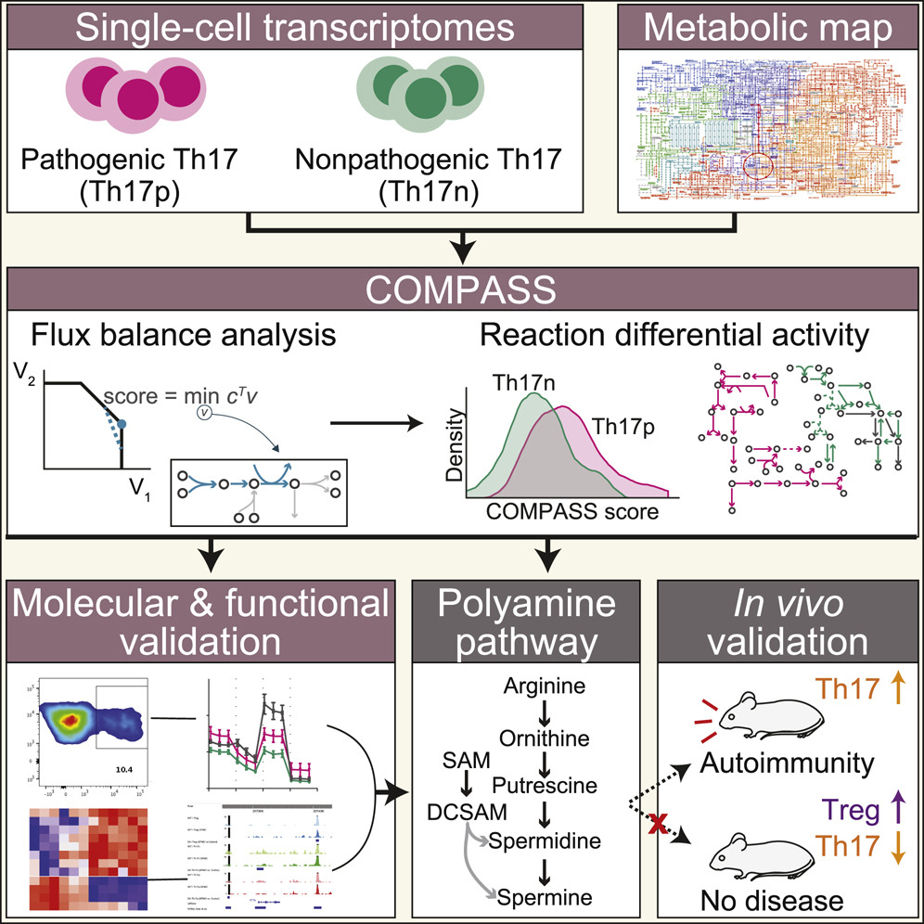
An application: COMPASS Metabolic modeling of single Th17 cells reveals regulators of autoimmunity, Wagner et al., Cell 2021
It belongs to the family of FBA algorithms that models metabolic fluxes (the rate by which chemical reactions convert substrates to products) through constraint-based optimization
It uses single-cell transcriptomic profiles to characterize cellular metabolic states at single-cell resolution and with network-wide comprehensiveness
It allows detection of targets across the entire metabolic network
Notes:
Recently, a new FBA method was developed, and it is named COMPASS.
COMPASS belongs to the family of FBA algorithms that model metabolic fluxes (the rate by which chemical reactions convert substrates to products) through constraint-based optimization.
It uses single-cell transcriptomic profiles to characterize cellular metabolic states at single-cell resolution and with network-wide comprehensiveness.
This allows the detection of targets across the entire metabolic network
We took inspiration from an article published by an interdisciplinary team of scientists from the universities of California, MIT and Harvard: ’’ Metabolic modeling of single Th17 cells reveals regulators of autoimmunity’’ and here on the right we have a summary of what they accomplished

Slide 4
Notes:
Let’s see it in detail here.
So they started with 2 distinct cultures of Th17: one being composed of pathogenic Th17 and the other composed of nonpathogenic Th17 cells.
To compute the flux balance analysis, they used COMPASS which integrates the single-cell transcriptomic data and a metabolic model (RECON2) and calculate COMPASS scores. We will see later what these scores are. From that, they went on to determine the reaction differential activity of the cells and deduced some observations.

Slide 5
Notes:
Those deductions were then validated through wet lab essays like molecular and functional validation, polyamine pathway analysis and also in vivo experiment.

Slide 6
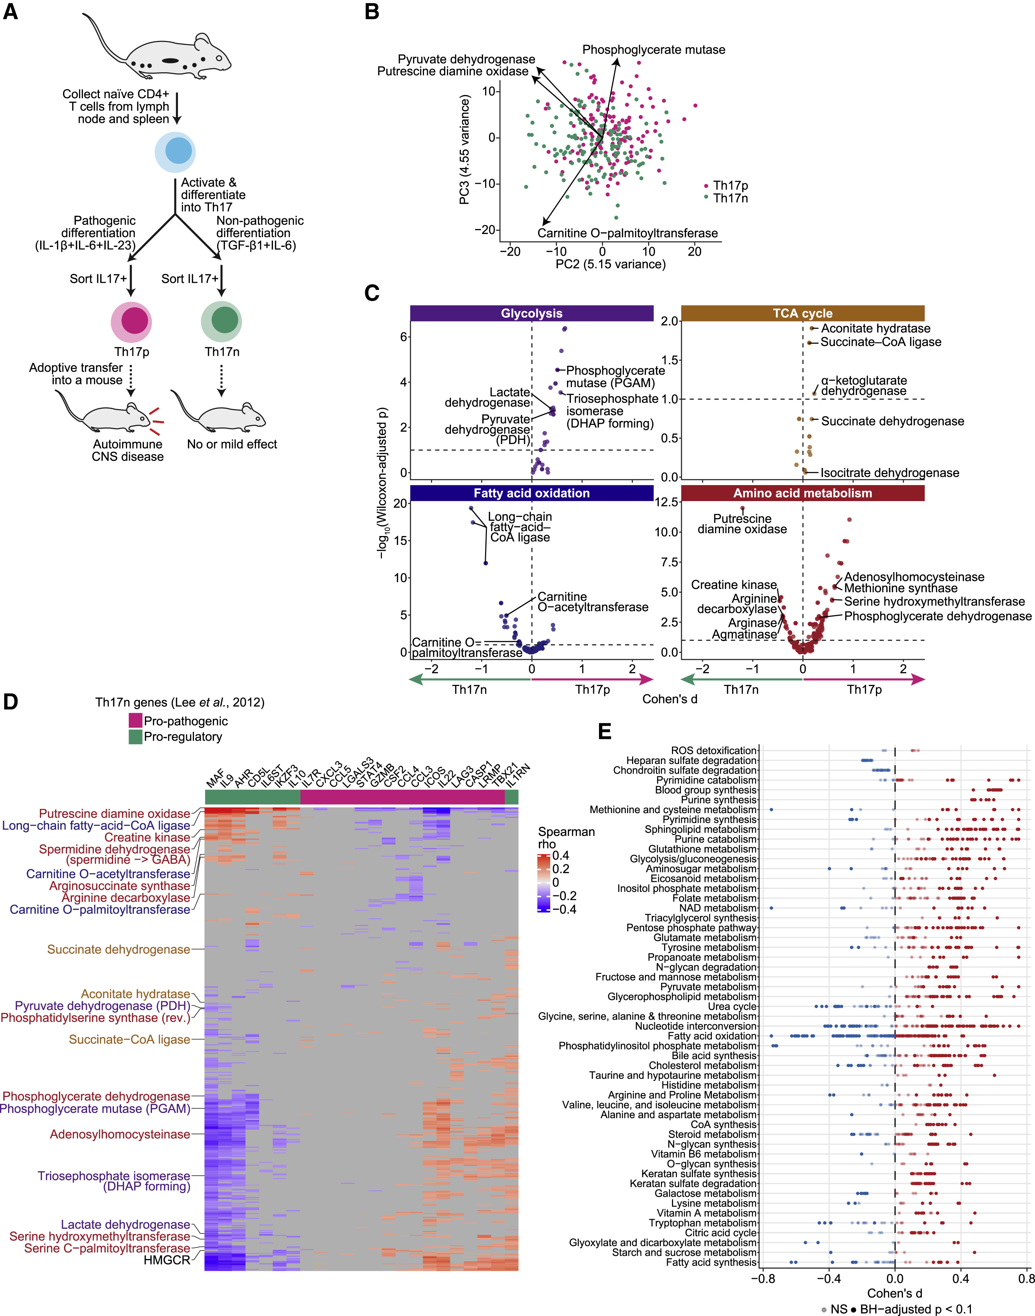
Some results
Volcano plot to study relationship between reactions’ adjusted p-values and effect sizes, split into manually curated macro groups of reactions. Points over the horizontal lines represent differentially consistent reactions. Reactions on the left side of each plot are associated with Th17n cells and vice versa for the reactions on the right side.
Differentially consistent reactions grouped by reaction subsystems. Each dot represents the effect-size for a specific reaction. A positive effect-size is associated with Th17p cells.
Notes:
Here are some concrete results they came up with.
On the first graph, we have a volcano plot to study the relationship between reactions’ adjusted p-values and effect sizes, split into manually curated macro groups of reactions. The points that are over the horizontal dotted lines represent differentially consistent reactions. Reactions on the left side of each plot are associated with non-pathogenic cells and vice versa for the reactions on the right side. Liquid chromatography-mass spectrometry (LC/MS) metabolomics indicated that glycolytic metabolites were higher in Th17p than in Th17n. TCA metabolites, apart from succinate, were more abundant at steady state in Th17p than in Th17n, consistent with Compass prediction
On the second we have differentially consistent reactions that are grouped by reaction subsystems where each dot represents the effect size for a specific reaction. A positive effect size is associated with pathogenic cells whereas a negative effect size is associated with non-pathogenic cells.

Slide 7


What if we apply COMPASS on our data?
Disease: Experimental autoimmune encephalomyelitis (EAE)
Objective: compare the leukocytes that are in the spinal cord in the diseased toward its control (mice injected with a mixture that recreates inflammation that is not EAE specific) in the two stages of disease (onset and chronic).
Assumption: These diseases are influenced, if not induced, by precisely this migration of leukocytes from the blood into the central nervous system
Single-Cell RNA-Seq Data
TSNE 2
CD4 cells
TSNE 2
Onset
Chronic
TSNE 1
TSNE 1
Notes:
Let’s move to our study case: Experimental autoimmune encephalomyelitis (EAE)
Objective: compare the leukocytes that are in the spinal cord in the diseased toward its control (mice injected with a mixture that recreates inflammation that is not EAE specific) in the two stages of disease (onset and chronic).
Assumption: These diseases are influenced, if not induced, by precisely this migration of leukocytes from the blood into the central nervous system
We have Single-cell RNA-Seq data previously analysed with assigned cell types, but for now, we are focusing on the CD4 cells as done in the paper

Slide 8
TSNE 2
TSNE 1

Slide 9
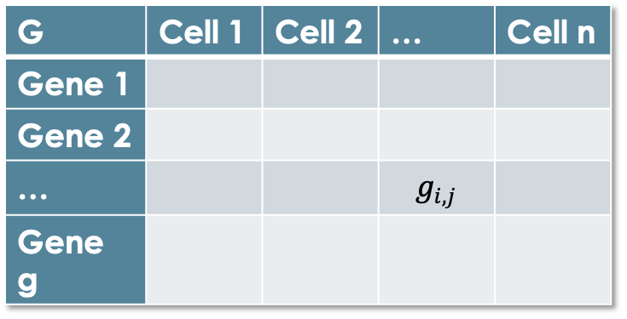


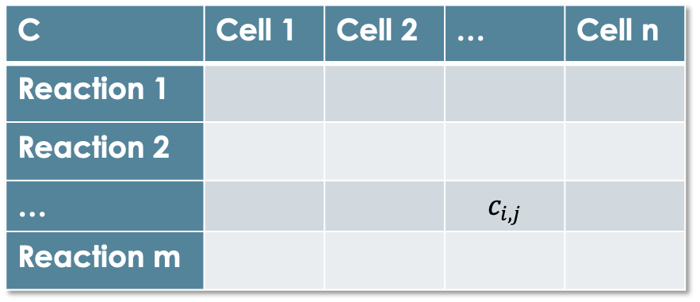
In brief, what are we doing?
With some ready-to-use COMPASS ingredients
GSMM
Algorithm parameters
Gene-to-reaction mapping
Media information
From a gene expression matrix
We obtain a reaction consistencies matrix
G | Cell 1 | Cell 2 | … | Cell n
Gene 1
Gene 2
… |  |  | $$g_{i,j}$$
Gene g
C | Cell 1 | Cell 2 | … | Cell n
Reaction 1
Reaction 2
… |  |  | $$c_{i,j}$$
Reaction m
Entries of the expression matrix, $g_{i,j}$ represent:
normalized expression values
cleaned from batch effects
scaled to TPM or CPM
Entries of the reaction consistencies matrix, $c_{i,j}$ represent the propensity of the cell to use that reaction.
Notes:
In brief, what we do in the first place is to run COMPASS.
The input is a gene expression matrix where we have genes on the rows and cells on the columns. Entries of the expression matrix, $g_{i,j}$ represent:
normalized expression values
cleaned from batch effects
scaled to TPM or CPM counts
COMPASS has ready-to-use ingredients like GSMM, algorithm parameters and gene-to-reaction mapping to integrate with our input and compute the output
That is another matrix where instead of gene expression we have reaction consistencies. Entries of the reaction consistencies matrix, $c_{i,j}$ represent the propensity of the cell to use that reaction.

Slide 10
Let’s perform some analysis
Exploratory analysis of Single-Cell RNA-Seq expression data
Exploratory analysis of reaction consistencies matrix generated by COMPASS
Cell clustering based on cell’s metabolic profile
Characterize clusters
Visualize differentially consistent reactions and metareactions between group of cells
Notes:
This is the list of analysis we've performed so far

Slide 11
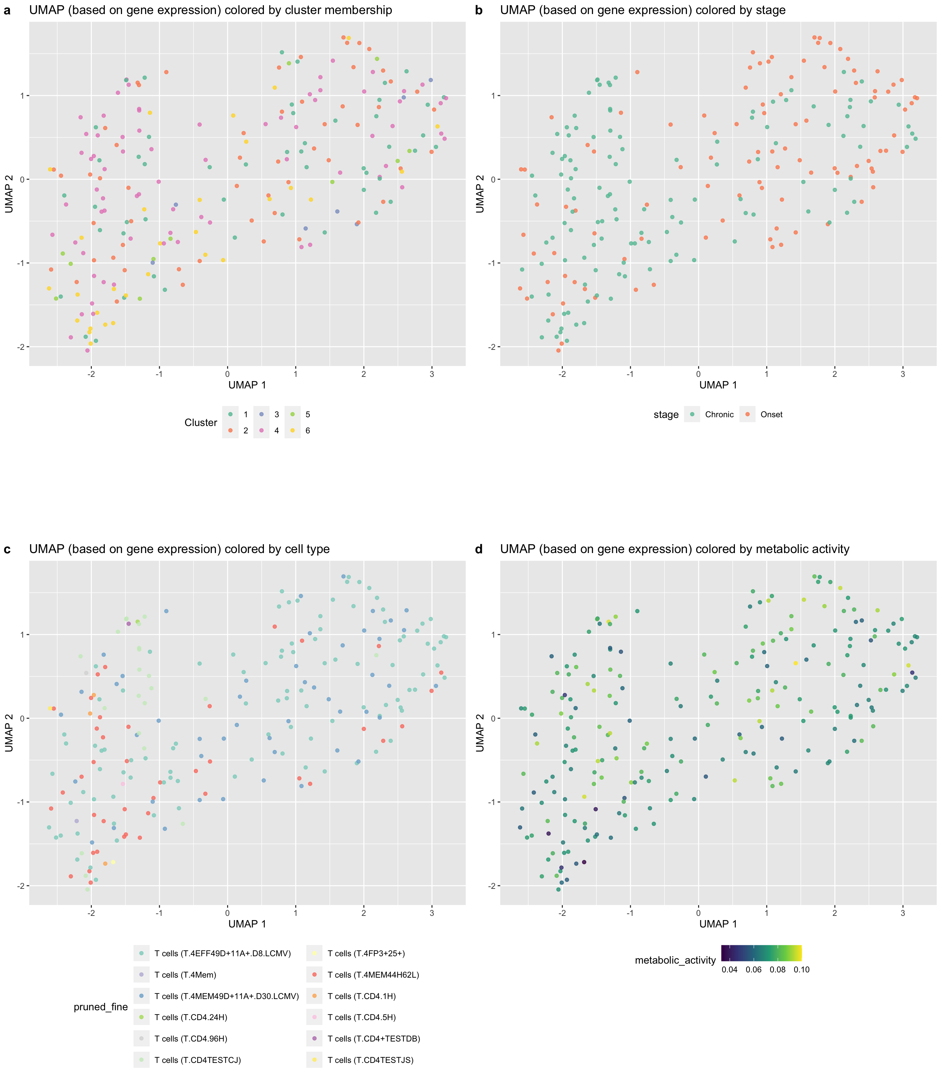
Exploratory analysis Single-Cell RNA-Seq data
Many T.CD4TESTCJ
Many Chronic cells
Many
T.4EFF49D
T.4MEM49D
Many Onset cells
Many T.4MEM44H62L
Notes:
[Interprete the graphs. The animation does the job. Conclusions only at the end]
We did a dimensionality reduction of our gene expression matrix using UMAP method and here are the results:
In the graph on the left cells are coloured by their stage while in the second graph we have the same UMAP plot this time coloured by cell type.
We don’t have a neat separation based on any of these 2 features, but we can spotlight a slight tendency

Slide 12
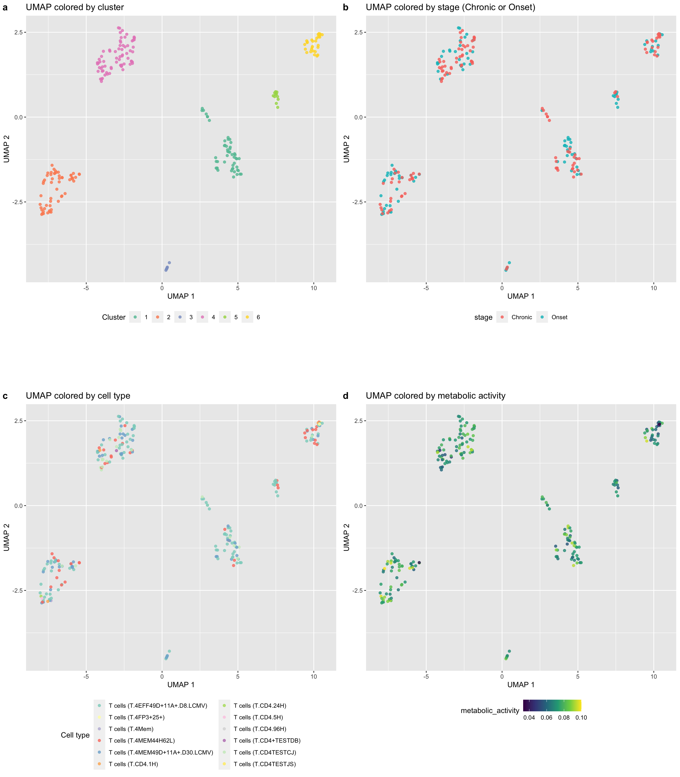
Exploratory analysis Metabolic data generated by COMPASS
Unclear separation between cell types
Unclear separation between Onset and Chronic cells
Notes:
[Interprete the graphs. The animation does the job. Conclusions only at the end]
We then did then same type of dimensionality reduction over the metabolic data generated by COMPASS and …

Slide 13
Exploratory analysis Metabolic data generated by COMPASS
A cell’s total expression is the extent to which it expresses any of its genes
Its metabolic expression is the extent to which it expresses its metabolic genes
Its metabolic activity is the ratio of its metabolic expression to its total expression
Unclear gradient for metabolic activity
Notes:
Here we colour the cells based on their metabolic activity. To understand what is defined as metabolic activity we must first introduce 2 definitions whic are: - cell’s total expression: the extent to which it expresses any of its genes
And cell’s metabolic expression: the extent to which it expresses its metabolic genes
Then the metabolic activity is the ratio of its metabolic expression to its total expression

Slide 14
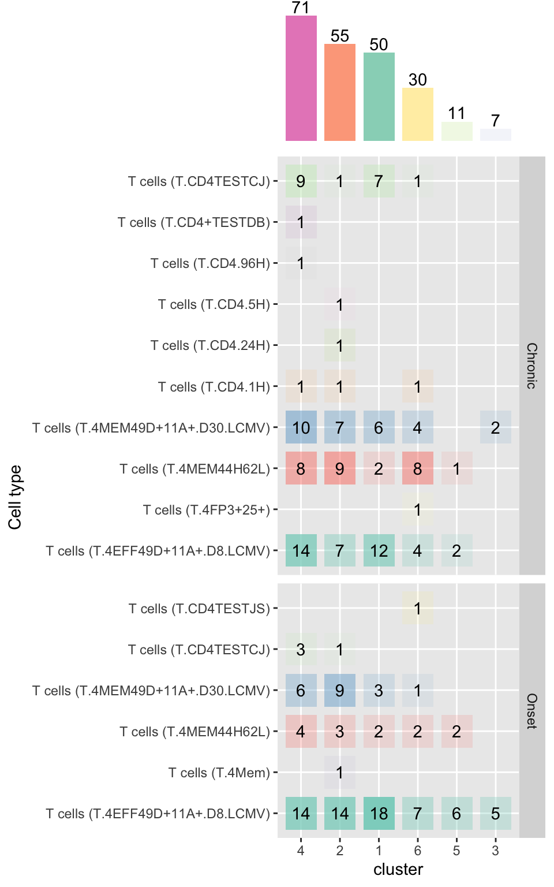
Exploratory analysis Metabolic data generated by COMPASS
most populated
6 clusters of cells
Notes:
Let’s get deep into our

Slide 15
Exploratory analysis Metabolic data generated by COMPASS on gene expression data
What if we color the gene expression UMAP with the new clusters?
We don’t observe patterns
Possible intepretations:
The gene expression alone is not a good proxy (tool) to describe cell activities
Clusters are based only on metabolic genes which represent only a small amount of the total gene expression
Unclear cluster separation
Notes:
L’ultimo punto non mi risulta. Gene expression matrix riporta tutti i geni espressi dalle cellule

Slide 16
Characterise clusters Why?
Unsupervised dimensionality reduction representation highlighted the presence of 6 very well separated clusters of CD4 cells
As the main source of metabolic profiles variability can be summarised through these clusters, we need to characterise them
Stages, cell types, and metabolic activities of cells don’t seem to determine the differences in the first two UMAP dimensions for the CD4 cells
Notes:
At this point, we decided to characterize the clusters.
Why?
Well

Slide 17
Characterise clusters How?
One vs All: For each cluster we compare its cells with all the other cells
Approach
Test
We use the Wilcoxon Rank Sum test on the reaction consistencies to find differentially consistent reactions between group of cells
Correction
BH correction method is used to correct for multiple testing
Effect-size
Cohen's D statistic is used as effect size. It is computed as the difference between the average reaction consistencies of the two groups of cells and divided by their averaged standard deviation
One vs One: Compare the cells of a cluster to the cells of another one

Slide 18
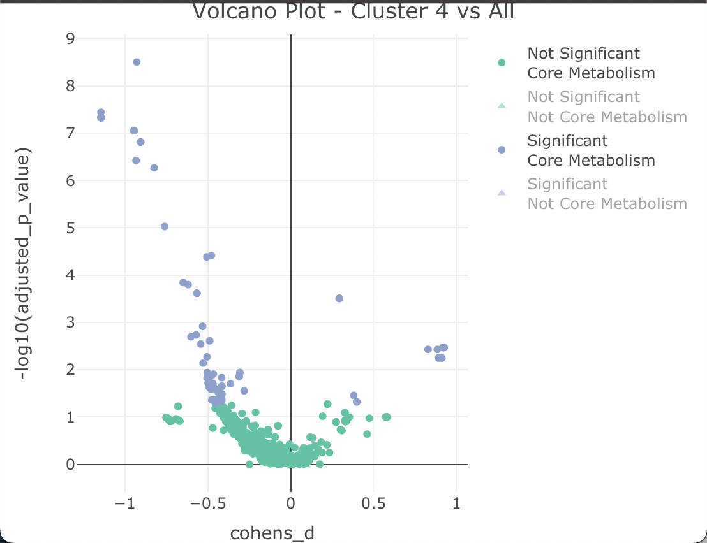
Characterise clusters – Volcano plot An example on cluster 4 – the most populated
A reaction is considered being part of the core metabolism when:
Its Enzyme Commission number, a numerical classification scheme for enzymes, based on the chemical reactions they catalyze, is defined
Its confidence is 0 (i.e., confidence not evaluated) or 4 (i.e., confidence supported by biochemical evidence)
A reaction is considered significant when:
Its adjusted p-value is below the 0.05 threshold
Volcano plot for core metabolism reactions in cluster 4 vs all the other clusters.
Notes:
We took as example, the cluster 4 as it is the most populated one

Slide 19
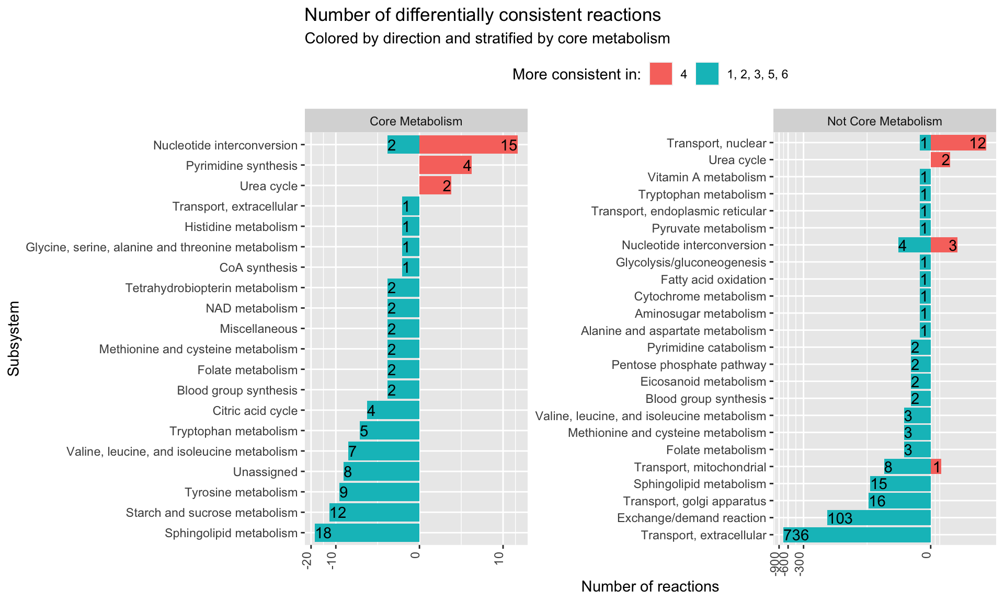
Characterise clusters – Subsystems An example on cluster 4 – the most populated
Each bar represents the number of differentally consistent reactions
A subsystem is made by reactions of the same metabolic pathway
Consistent in Cluster 4
Consistent in Clusters 1,2,4,5,6

Slide 20
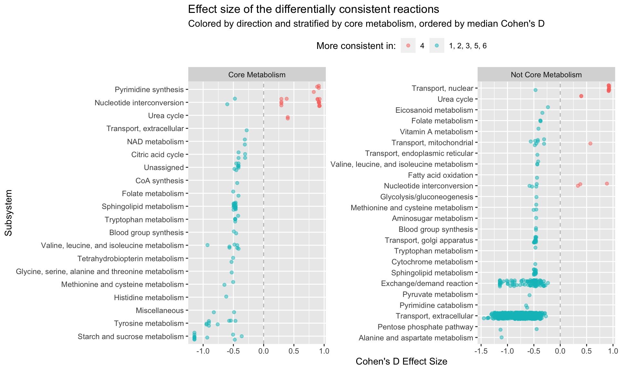
Characterise clusters – Effect sizes An example on cluster 4 – the most populated
Each dot represents the effect size of a single differentially conisistent reaction
The subsystem are now ordered by median effect size
Very consistent in Cluster 4
Very consistent in Clusters 1,2,4,5,6

Slide 21
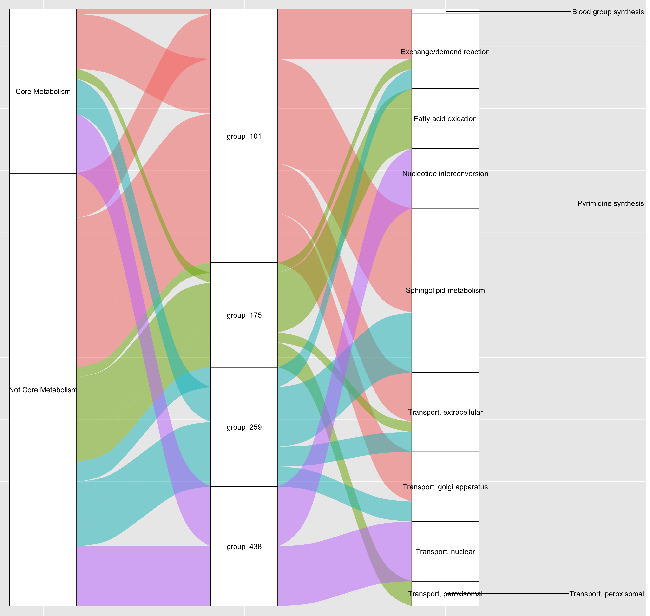
Characterise clusters - Metareactions An example on cluster 4 – the most populated
Metareaction
A group of reactions which are strongly correlated
Reactions inside a metaraction belong to several subsystems

Slide 23
Discussion
Could the metabolic profile of a given cluster be of aid to identify new cell types/states/trajectories?
Can we trust the clusters?
Do they represent different cell states?
We are only considering metabolic genes, which is different from considering all genes…
Could the analysis be extended to other datasets?
A different cell type where some prior knowledge is already available
Cells with a more specific signature

